Slide 1
dress service
Help us dress you

Slide 2
Our purpose
Provide excellent service in order to make the customer return and buy again
From the customer perspective
The purpose of our system is to give the customer immediate and accurate response for his questions and problems that may appear in using websites of ordering clothes.
From the representative worker perspective
The representative worker does not have to deal with the customer's mood and temperament directly during a telephone call.
All the tickets information saved orderly and accessible.

Slide 3

Hello!
This is our team:
Tair Shriki
Chaya levin
Tair Shriki
Chaya levin
Developer,SRS,
Test case,STP,
DFD.
Bluma Rosenfeld
Developer,SRS,
Test case,STP.
Bluma Rosenfeld
Ruth Bracha cohen
Ruth Bracha cohen
Developer,SRS,
Test case,STP.
Developer,SRS,Test case,STP,
DFD.

Slide 4
UNIQUE concept
Search for tickets in a variety of ways and by particular search for a free word
We developed a check function that make sure that robots do not use our software
“Forget password”, user can always remember his password by answering his personal question.

Slide 5
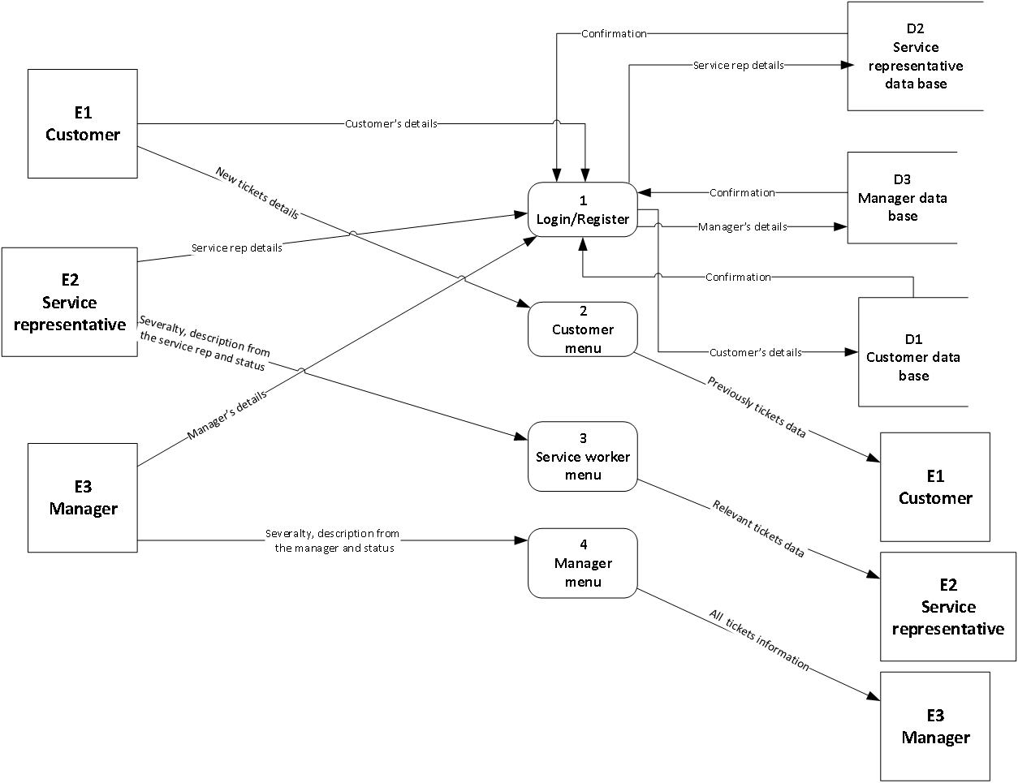
DFD 0

Slide 6
Risks involved:
Absence
Developer going to be absence from the development process
Miscommunication
Miscommunication between member of the team Cause Conflicts and bugs
Technical failures
External injury that occurs during the program.
Memory
The system will run out of memory
Environment
The code may work not properly in a different software environment

Slide 7
Various persisting bugs
System function | Action | Bug details | Priority | Open/ Closed
General | Skipping of places that need to get input | The buffer saved the char ‘enter’, and made the next input field take the ‘enter’ instead of the real input | High | Closed
General | Infinity loop of error message | When the input should get only a number and the user entering a char. | Med | Closed
Register | User enter does not existing country without any error message | The system doesn't has a list of existing countries , As a result, each country approves and no error message appears | Low | Open

Slide 8
Continued
System function | Action | Bug details | Priority | Open/ Closed
login | In the third time provide invalid password | The system accept the password as if it a correct one | High | Closed
Create new ticket | The user entering invalid number for categories and there is no error message | The system accept all the number even if they are not in the range and doesn't require to provide different number | Med | Closed
Create new ticket | Accept any items/orders number that the user provide | The system doesn't has a database of items/orders number and accept all kind of strings | Med | Closed

Slide 9
Unresolved challenges
Will be resolved in the next version
Not easy and unfriendly program to use software , as a result of not using GUI
In ‘forgot password’ function the system should send to the users email an option to change his password

Slide 10
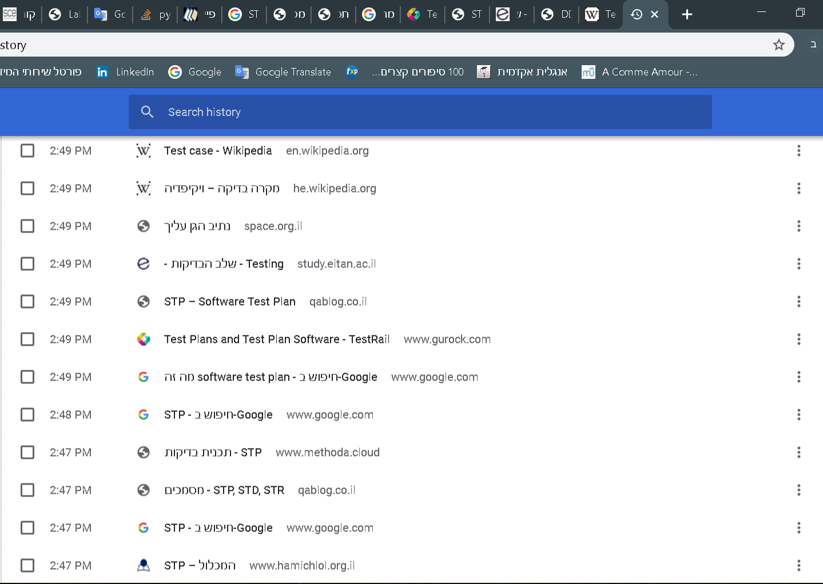
Place your screenshot here
Self learning
During the project, we studied independently new material.
Fortheremore, we studied how to deepened our thinking and ability to learn individually.

Slide 11
Main challenges
Resources are blocked
Coordination between group members' work into a uniform and orderly document
Lack of experience in writing software documents
Problems we didn't know how to deal with in the code
Short time

Slide 12
Post-project
Improved teamwork ability, and work better together
Improving the
independent workability of each member in the team
Creating a project that works, and real-world integration capabilities

Slide 13

Thanks!
our office
Any questions?

Slide 14
Most Prominent Requirements
בס"ד
Login to the system
Register as a customer
Create a new ticket
Manager queries
Search by some indexes

